Slide 1
New CMS Device Criteria
RAD & HMV Coverage Updates – NCD 240.9
NCD Effective: June 9, 2025 | Claims Payable: October 22, 2025
LCD L33800 revised Oct 9, 2025 (retroactive to 6/9/2025)
LCDs still pending for non-COPD indications
Sections: COPD | Restrictive/NMD | OHS | Hypoventilation

Slide 2
COPD NCD Implementation Timeline & LCD Status
June 9, 2025
Oct 9, 2025
Oct 22, 2025
1
2
3
NCD 240.9 Effective
LCD L33800 Revised
Claims Payable
National coverage policy in force
Aligned with NCD (retroactive to 6/9)
DME MACs processing new criteria
What Changed in LCD L33800
Removed old “Severe COPD” criteria
Added “CRF Consequent to COPD” – defers to NCD 240.9
Updated KX modifier instructions
Non-discretionary revision (21st Century Cures Act)
What This Means for Providers
COPD: LCD is live now – bill under NCD 240.9 today
Non-COPD: LCDs still pending – MACs retain authority

Slide 3
COPD NCD: RAD with Backup Rate – Initial Coverage Criteria
Persistent Hypercapnia
PaCO2 \u2265 52 mmHg (awake ABG, on prescribed FiO2)
1
AND
Sleep Apnea Ruled Out
Not the predominant cause of hypercapnia (formal sleep testing NOT required)
2
AND
Ability to Support Home NIV
Patient has physical/cognitive ability, or has a caregiver who can assist
3
AND
Clinical Stability (one of):
a) Stable COPD \u2265 2 weeks (no new symptoms); OR b) \u2265 2 weeks post-hospitalization after exacerbation
4
✓ All met = E0471 covered for initial 6-month period
Notes:
NCD 240.9 – RAD WITH BACKUP RATE FEATURE: INITIAL COVERAGE CRITERIA (COPD)
CMS will cover in the home a RAD with backup rate feature to deliver high intensity noninvasive ventilation (NIV) as treatment for patients with chronic respiratory failure (CRF) consequent to COPD.
A RAD with backup rate feature is covered in the home for an initial 6-month period for patients with COPD when ALL of the following criteria are met:
1. The patient exhibits persistent hypercapnia as demonstrated by PaCO2 ≥ 52 mmHg by arterial blood gas during awake hours while breathing his/her prescribed FiO2; AND
2. Sleep apnea is not the predominant cause of the hypercapnia (formal sleep testing is not required if, per the treating clinician, the patient does not experience sleep apnea as the predominant cause of the hypercapnia); AND
3. The patient exhibits the physical and cognitive ability to support home ventilation or has a caregiver who can assist; AND
4. The patient demonstrates one of the following:
a. Stable COPD, without increase in or new onset of more than one respiratory symptom (cough, sputum production, sputum purulence, wheezing, or dyspnea) lasting 2+ days and no change of pharmacological treatment during the 2-week period before initiation of NIV; OR
b. Hypercapnia present for at least 2 weeks post hospitalization after resolution of an exacerbation of COPD requiring acute NIV.
By the end of the initial 6-month period, a RAD with backup rate feature must be utilized as high intensity therapy, defined as a minimum IPAP ≥ 15 cm H2O and backup respiratory rate of at least 14 breaths per minute.
Source: CMS NCD 240.9 – Effective June 9, 2025

Slide 4
COPD NCD: RAD without Backup Rate – Initial Coverage Criteria
E0470: Patient cannot tolerate high-intensity NIV or backup rate is medically inappropriate
Persistent Hypercapnia
PaCO2 ≥ 52 mmHg (awake ABG, on prescribed FiO2)
1
AND
Sleep Apnea Ruled Out
Not the predominant cause of hypercapnia (formal sleep testing NOT required)
2
AND
Ability to Support Home NIV
Patient has physical/cognitive ability, or has a caregiver who can assist
3
AND
Clinical Stability (one of):
a) Stable COPD ≥ 2 weeks (no new symptoms); OR b) ≥ 2 weeks post-hospitalization after exacerbation
4
✓ All met = E0470 covered for initial 6-month period
Notes:
NCD 240.9 – RAD WITHOUT BACKUP RATE FEATURE: INITIAL COVERAGE CRITERIA (COPD)
CMS will cover in the home a RAD without backup rate feature for a patient with CRF consequent to COPD who cannot tolerate high intensity NIV or for whom the backup rate feature is otherwise medically inappropriate.
A RAD without backup rate feature is covered in the home for an initial 6-month period for patients with COPD when all of the following criteria are met:
1. The patient exhibits persistent hypercapnia as demonstrated by PaCO2 ≥ 52 mmHg by arterial blood gas during awake hours while breathing his/her prescribed FiO2; AND
2. Sleep apnea is not the predominant cause of the hypercapnia (formal sleep testing is not required if, per the treating clinician, the patient does not experience sleep apnea as the predominant cause of the hypercapnia); AND
3. The patient exhibits the physical and cognitive ability to support home ventilation or has a caregiver who can assist; AND
4. The patient demonstrates one of the following characteristics:
a. Stable COPD, without increase in or new onset of more than one respiratory symptom (cough, sputum production, sputum purulence, wheezing, or dyspnea) lasting 2+ days and no change of pharmacological treatment during the 2-week period before initiation of NIV; OR
b. Hypercapnia present for at least 2 weeks post hospitalization after resolution of an exacerbation of COPD requiring acute NIV.
AND... OUTPATIENT STATUS DEFINITION:
(i) RAD with Backup Rate Feature: By the end of the initial 6-month period, a RAD with backup rate feature must be utilized as high intensity therapy, defined as a minimum IPAP ≥ 15 cm H2O and backup respiratory rate of at least 14 breaths per minute.
Source: CMS NCD 240.9 – Effective June 9, 2025

Slide 5
COPD NCD: RAD with or without Backup Rate – No Oximetry Requirement
Key Change: Nocturnal oximetry requirement REMOVED
OLD LCD (L33800)
NEW NCD 240.9
ABG PaCO2 ≥ 52 mmHg
Sleep oximetry: SpO2 ≤ 88% for ≥ 5 min (min 2-hr recording) on O2 at 2 LPM or prescribed FiO2
Sleep apnea must be considered and ruled out with CPAP trial
Clinical stability criteria
ABG PaCO2 ≥ 52 mmHg (unchanged)
No oximetry required
No formal sleep testing required – clinician judgment sufficient to rule out sleep apnea
Clinical stability criteria (unchanged)
Physical/cognitive ability or caregiver (unchanged)
Impact: Removes a major barrier – patients no longer need overnight sleep study to qualify for RAD
Notes:
NCD 240.9 – RAD WITH OR WITHOUT BACKUP RATE: KEY CHANGE – NO OXIMETRY REQUIREMENT
IMPORTANT: Under the new NCD, the previous requirement for nocturnal oximetry (sleep oximetry showing O2 saturation ≤ 88% for ≥ 5 cumulative minutes) has been REMOVED from the initial coverage criteria for RADs.
Previously under the LCD (L33800), coverage of an E0470 required:
• ABG PaCO2 ≥ 52 mmHg (still required under new NCD)
• Sleep oximetry showing O2 sat ≤ 88% for ≥ 5 cumulative minutes of nocturnal recording time (minimum 2 hours), done while breathing O2 at 2 LPM or prescribed FiO2 (REMOVED)
• Sleep apnea considered and ruled out with CPAP trial (MODIFIED – formal sleep testing no longer required)
Under the NEW NCD 240.9, initial coverage criteria are:
1. PaCO2 ≥ 52 mmHg by ABG during awake hours on prescribed FiO2
2. Sleep apnea is not the predominant cause of hypercapnia (formal sleep testing NOT required if clinician determines sleep apnea is not predominant cause)
3. Physical/cognitive ability for home ventilation or caregiver available
4. Stable COPD (2-week stability) OR post-hospitalization hypercapnia (≥ 2 weeks post discharge)
This is a significant simplification that removes a major barrier to qualification.
Source: CMS NCD 240.9 vs. prior LCD L33800

Slide 6
COPD NCD: RAD – Recommended Approach for Backup Rate Decision
Can patient tolerate high-intensity NIV?
(IPAP ≥ 15 cmH2O, backup rate ≥ 14 BPM)
↓ YES
↓ NO
E0471 – With Backup Rate
High-intensity NIV
IPAP ≥ 15 cmH2O
Backup rate ≥ 14 BPM
Must achieve high-intensity by month 6
E0470 – Without Backup Rate
Cannot tolerate high-intensity NIV
Backup rate medically inappropriate
Same qualifying criteria apply
Document rationale for E0470 selection
⚠ Call the DME vendor BEFORE ordering
Discuss patient clinical picture and device selection – do not just “fax and pray”
Notes:
NCD 240.9 – RECOMMENDED APPROACH: DECIDING ON BACKUP RATE FEATURE
Practical guidance for clinicians and DME providers on selecting RAD with vs. without backup rate feature under the new NCD:
RAD WITH BACKUP RATE (E0471):
• Covered for initial 6-month period for COPD patients meeting all criteria
• PaCO2 ≥ 52 mmHg by ABG while awake on prescribed FiO2
• Sleep apnea not predominant cause of hypercapnia
• Physical/cognitive ability for home ventilation (or caregiver)
• Stable COPD (≥ 2 weeks stability) OR post-hospitalization hypercapnia (≥ 2 weeks post discharge)
• By end of 6-month period: must use high intensity therapy (IPAP ≥ 15 cm H2O, backup rate ≥ 14 BPM)
RAD WITHOUT BACKUP RATE (E0470):
• For patients who CANNOT tolerate high intensity NIV
• Or for whom backup rate feature is medically inappropriate
• Same initial criteria (PaCO2, sleep apnea, stability) apply
• Covered for initial 6-month period
KEY DECISION POINT: Call the DME Vendor – discuss patient clinical picture before ordering. Consider whether the patient can tolerate high intensity settings. Do not just "FAX and Pray" – coordinate with the DME vendor to ensure proper device selection and documentation.
Documentation requirements:
• ABG showing PaCO2 ≥ 52 mmHg
• Clinical assessment ruling out sleep apnea as predominant cause
• Stability assessment (2-week window) or post-hospitalization status
• Justification for device selection (with or without backup rate)
Source: CMS NCD 240.9 – Effective June 9, 2025

Slide 7
COPD NCD: RAD upon Hospital Discharge – Immediate Coverage
Hospital
Patient on RAD or ventilator during inpatient stay
Within 24 hrs of Discharge
RAD/ventilator used within 24-hr period prior to discharge
Home Coverage
RAD covered immediately for initial 6 months
Requirement 1
RAD or ventilator used within 24 hours prior to hospital discharge
Requirement 2
Clinician documents risk of rapid symptom exacerbation or PaCO2 rise after discharge
Simplified: No PFT, no oximetry, no ABG required for this pathway
Notes:
NCD 240.9 – RAD UPON HOSPITAL DISCHARGE: IMMEDIATE COVERAGE (COPD)
(iii) RAD Upon Hospital Discharge:
CMS will cover in the home a RAD with or without backup rate feature immediately upon hospital discharge for an initial 6-month period for patients with acute on chronic respiratory failure due to COPD, if:
1. The patient required either a RAD or ventilator within the 24-hour period prior to hospital discharge; AND
2. The treating clinician determines that the patient is at risk of rapid symptom exacerbation or rise in PaCO2 after discharge.
KEY POINTS:
• No PFT (pulmonary function test) required for hospital discharge pathway
• No nocturnal oximetry required for hospital discharge pathway
• This is a simplified pathway for acute-on-chronic patients
• Device must have been used within 24 hours prior to discharge
• Clinician must document risk of rapid symptom exacerbation or PaCO2 rise
SPECIAL ADDITIONAL DOCUMENTATION:
• The treating clinician determines the patient is at risk of rapid symptom exacerbation or rise in PaCO2 after discharge
• Documentation must support medical necessity
• Hospital records should show RAD/ventilator use within 24 hours of discharge
Note: Patients covered under this pathway still need to meet continuing usage criteria at the 6-month evaluation.
Source: CMS NCD 240.9 – Effective June 9, 2025

Slide 8
COPD NCD: RAD – 6-Month Continuing Usage Evaluation
☑ Compliance
Clinician determines patient uses RAD:
≥ 4 hours per 24-hour period
On ≥ 70% of days in a 30-day period
☑ Clinical Outcome (≥ 1)
PaCO2 normalized (< 45 mmHg)
PaCO2 stabilized (< 5 mmHg change)
20% reduction in PaCO2 from baseline
Improved sleep quality or symptoms (headache, fatigue, SOB, confusion)
AND
⚠ Due by end of 6-month initial coverage period – coverage stops if not met
Notes:
NCD 240.9 – CONTINUING USAGE CRITERIA FOR RAD (COPD) – 6-MONTH EVALUATION
(b) Continuing Usage Criteria for a RAD:
Patients must be evaluated at least twice within the first year after initially receiving a RAD. Evaluations must occur by the end of the six-month initial coverage period and again during months 7-12.
FIRST EVALUATION (by 6 months after receiving initial coverage):
The treating clinician must establish that usage criteria and clinical outcomes are being met. Specifically, the patient must:
1. Be determined by a clinician to use the RAD at least 4 hours per 24-hour period, on at least 70% of days in a 30-day period; AND
2. Achieve at least one of the following clinical outcomes:
- Normalization of PaCO2 (PaCO2 < 45 mmHg)
- Stabilization of PaCO2 (change of < 5 mmHg from baseline)
- 20% reduction in PaCO2 from baseline
- Improvement in sleep quality or respiratory symptoms (headache, fatigue, shortness of breath, confusion, sleep quality)
IMPORTANT: These are strict continuing usage requirements. If not met, coverage may be denied beyond the initial 6-month period.
Source: CMS NCD 240.9 – Effective June 9, 2025

Slide 9
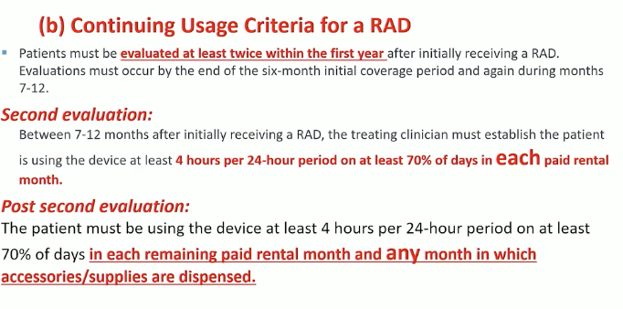
COPD NCD: RAD – Follow-Up Rental Period (Months 7-13)
Notes:
NCD 240.9 – RAD FOLLOW-UP RENTAL PERIOD: MONTHS 7-13 (COPD)
During the follow-up rental period (13 months total rental period):
(b) Continuing Usage Criteria for a RAD (continued):
Second Evaluation (between 7-12 months after initially receiving a RAD):
The treating clinician must establish the patient is using the device at least 4 hours per 24-hour period on at least 70% of days in each paid rental month.
Post Second Evaluation:
The patient must be using the device at least 4 hours per 24-hour period on at least 70% of days in each remaining paid rental month and any month in which accessories/supplies are dispensed.
KEY REQUIREMENTS DURING FOLLOW-UP:
- Usage: At least 4 hours per 24-hour period
- Frequency: At least 70% of days in each paid rental month
- Must maintain compliance throughout the entire rental period
- Accessories and supplies coverage is tied to continued usage compliance
- Two evaluations required in first year: one at 6 months, one during months 7-12
Source: CMS NCD 240.9 – Effective June 9, 2025

Slide 10
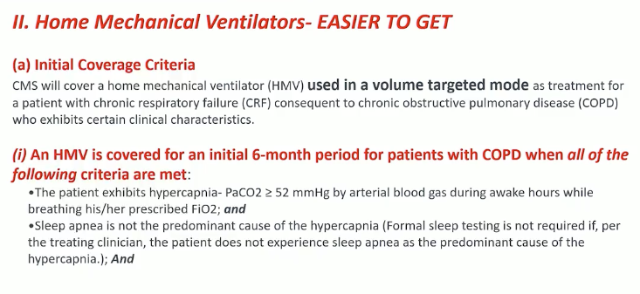
COPD NCD: HMV – Volume Mode Initial Coverage Criteria
Notes:
NCD 240.9 – HOME MECHANICAL VENTILATORS (HMV): INITIAL COVERAGE CRITERIA (COPD)
II. Home Mechanical Ventilators (HMVs):
CMS will cover an HMV used in a volume targeted mode as treatment for a patient with CRF consequent to COPD who exhibits certain clinical characteristics.
An HMV is covered for an initial 6-month period for patients with COPD when ALL of the following criteria are met:
1. The patient exhibits hypercapnia as demonstrated by PaCO2 ≥ 52 mmHg by arterial blood gas during awake hours while breathing his/her prescribed FiO2; AND
2. Sleep apnea is not the predominant cause of the hypercapnia (formal sleep testing is not required if, per the treating clinician, the patient does not experience sleep apnea as the predominant cause of the hypercapnia); AND
3. The patient requires the alarms and internal battery of an HMV, because:
a. The patient is unable to effectively breathe on their own for more than a few hours; AND
b. The unrecognized interruption of ventilatory support is likely to cause a life-threatening condition if the patient or caregiver cannot be otherwise alerted as determined by the treating clinician; OR
4. Per the treating clinician, none of the below are likely to be achieved with consistent use of a RAD with backup rate feature for at least 4 hours per 24-hour period on at least 70% of days because the patient’s needs exceed the capabilities of a RAD as justified by the patient’s medical condition.
Source: CMS NCD 240.9 – Effective June 9, 2025

Slide 11
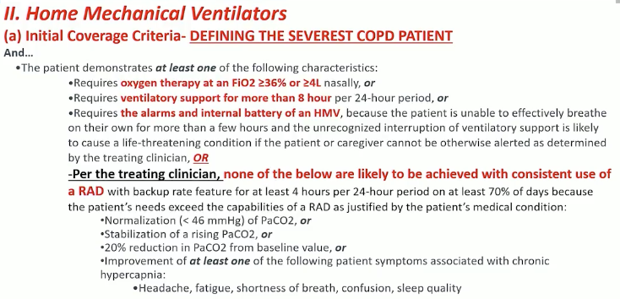
COPD NCD: HMV – Illness Severity & Clinical Outcomes
Notes:
NCD 240.9 – HMV: ILLNESS SEVERITY DESCRIPTORS & CLINICAL OUTCOMES (COPD)
HMV coverage requires that the patient’s needs exceed the capabilities of a RAD. Per the treating clinician, none of the below are likely to be achieved with consistent use of a RAD with backup rate feature for at least 4 hours per 24-hour period on at least 70% of days:
Clinical Outcomes that must be unlikely to be achieved with a RAD:
• Normalization of PaCO2 (PaCO2 < 45 mmHg)
• Stabilization of PaCO2 (change of < 5 mmHg from baseline)
• 20% reduction in PaCO2 from baseline
• Improvement in one or more of the following symptoms:
- Headache
- Fatigue
- Shortness of breath
- Confusion
- Sleep quality
And...
The patient must also demonstrate:
• Sleep apnea is not the predominant cause of the hypercapnia
• The patient exhibits the physical and cognitive ability to support home ventilation or has a caregiver who can assist
These illness severity criteria differentiate HMV patients from RAD patients – the HMV is for patients whose clinical needs cannot be adequately met by a RAD alone.
NOTE: HMV patients require volume targeted mode specifically. This is the first time CMS has established national coverage for HMV in COPD.
Source: CMS NCD 240.9 – Effective June 9, 2025

Slide 12
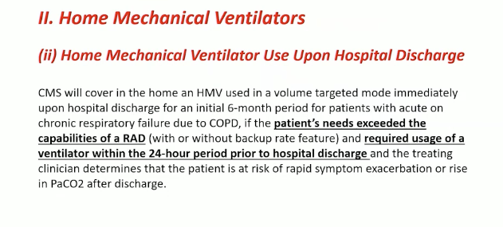
COPD NCD: HMV upon Hospital Discharge – Immediate Coverage
Notes:
PRESENTER NOTES – COPD NCD: HMV upon Hospital Discharge – Immediate Coverage
SLIDE SUMMARY:
This slide covers the NCD 240.9 criteria for immediate HMV (Home Mechanical Ventilator) coverage when a COPD patient is discharged from the hospital already on a ventilator.
KEY TALKING POINTS:
1. HOSPITAL DISCHARGE PATHWAY:
• This is a distinct pathway from the outpatient RAD qualification criteria
• Applies when a patient's needs EXCEEDED the capabilities of a RAD during hospitalization
• Patient must have required usage of a ventilator within the 24-hour period prior to hospital discharge
• Coverage is immediate upon discharge – no separate outpatient qualification testing required
2. CLINICAL REQUIREMENTS:
• The treating physician must document that the patient's respiratory failure required ventilator support (not just BiPAP/RAD) during the hospitalization
• ABG PaCO2 criteria still apply – documentation of chronic respiratory failure consequent to COPD
• The ventilator was medically necessary during the inpatient stay, not just trialed
3. WHY THIS MATTERS:
• Eliminates the gap between hospital discharge and home ventilator coverage
• Patients don't need to "re-qualify" through outpatient testing after hospitalization
• Covers the scenario where a patient was escalated from RAD to HMV during an acute exacerbation
• Streamlines the transition from inpatient to home ventilator support
4. DEVICE CODES:
• HMV codes: E0465 (invasive interface), E0466 (non-invasive interface), E0467 (multi-function)
• These are distinct from RAD codes E0470/E0471
• Volume-targeted ventilation mode is specified in the NCD
5. DOCUMENTATION REQUIREMENTS:
• Hospital records must support that ventilator was used and medically necessary
• Discharge summary should clearly state the patient requires continued HMV at home
• Treating practitioner's order for home ventilator must accompany the claim
Source: NCD 240.9 – Section II: Home Mechanical Ventilators, Hospital Discharge provisions

Slide 13
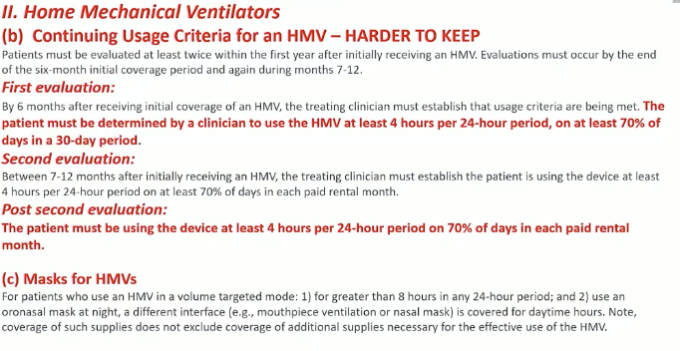
COPD NCD: HMV – Continuing Usage Requirements
Notes:
PRESENTER NOTES – COPD NCD: HMV – Continuing Usage Requirements
SLIDE SUMMARY:
This slide covers the NCD 240.9 requirements for maintaining HMV coverage beyond initial setup, including the two mandatory evaluations and mask/interface provisions. The editorial note "HARDER TO KEEP" highlights that continued HMV coverage has stricter ongoing requirements than initial qualification.
KEY TALKING POINTS:
1. FIRST EVALUATION (within 61–90 days of initiating HMV):
• Must be performed by the treating practitioner
• Must document that the patient is compliantly using the ventilator (average ≥ 4 hours per 24-hour period)
• Must document that the patient is benefiting from use
• If this evaluation is not completed, Medicare will NOT continue coverage beyond the first 3 months
• This mirrors the RAD 61-day re-evaluation but applies specifically to HMV
2. SECOND EVALUATION (within 6 months of initiating HMV):
• An additional follow-up evaluation is required
• Must again document continued compliance and benefit
• This is a MORE STRINGENT requirement than RAD – RAD only requires the single 61-day re-evaluation for restrictive/NMD
• Failure to complete this evaluation results in loss of coverage
3. POST-SECOND EVALUATION – ONGOING REQUIREMENTS:
• After the second evaluation, continued coverage requires periodic documentation of medical necessity
• The treating practitioner must continue to document ongoing need
• Device compliance monitoring remains important for audit purposes
4. "HARDER TO KEEP" – WHY THIS MATTERS:
• HMV has a higher documentation burden than RAD for continued coverage
• Two mandatory evaluations vs. one for RAD
• Providers need robust follow-up scheduling systems to avoid coverage gaps
• Missed evaluations = automatic loss of Medicare coverage, requiring re-qualification
5. MASKS FOR HMVs (Section c):
• Masks and interfaces are covered as accessories to the HMV
• Replacement schedules are defined in LCD L33800 and the Policy Article A52517
• Both invasive (tracheostomy) and non-invasive (nasal, oronasal, full face) interfaces are covered
• Mask type should match the clinical indication and patient tolerance
6. PRACTICAL IMPLICATIONS:
• Build evaluation milestones into the care plan at device initiation
• Document compliance data from device downloads at each visit
• Ensure the treating practitioner (not just the DME supplier) completes evaluations
• Keep documentation audit-ready – improper payment reviews specifically target evaluation timeliness
Source: NCD 240.9 – Section II: Home Mechanical Ventilators, Continuing Usage Requirements

Slide 14
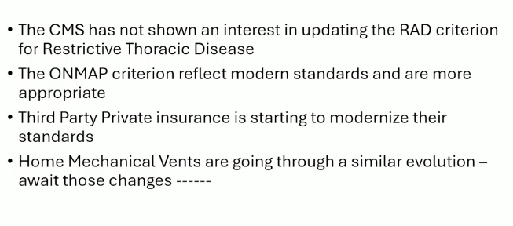
Restrictive/NMD: Current LCD Coverage Criteria (L33800)
Current
Notes:
LCD L33800 – RESTRICTIVE THORACIC DISORDERS: CURRENT COVERAGE CRITERIA
A RAD (E0470 or E0471) is covered for beneficiaries with restrictive thoracic disorders (i.e., neuromuscular diseases or severe thoracic cage abnormalities) when criteria A–C are met:
A. Documentation in the medical record of a neuromuscular disease (e.g., amyotrophic lateral sclerosis) or a severe thoracic cage abnormality (e.g., post-thoracoplasty for TB).
B. One of the following:
• An arterial blood gas PaCO2, done while awake and breathing the beneficiary’s prescribed FiO2, is ≥ 45 mmHg; OR
• Sleep oximetry demonstrates O2 saturation ≤ 88% for ≥ 5 minutes of nocturnal recording time (minimum recording time of 2 hours), done while breathing the beneficiary’s prescribed FiO2; OR
• For a progressive neuromuscular disease (e.g., ALS): maximal inspiratory pressure (MIP) < 60 cm H2O, or forced vital capacity (FVC) < 50% predicted.
C. COPD does not contribute significantly to the beneficiary’s pulmonary limitation.
If all criteria are met, either an E0470 or E0471 device (based on the treating practitioner’s judgment) is covered for the first 3 months of therapy.
NOTE – The ONMAP criteria reflect modern standards for documentation of impaired breathing. These include ABG PaCO2 ≥ 45 mmHg, nocturnal oximetry, and pulmonary function tests (MIP, FVC). A full PFT is not needed – specific measures suffice.
These criteria remain governed by LCD L33800 (MAC authority). The new COPD NCD 240.9 does NOT change restrictive/NMD criteria.
Source: LCD L33800 – Respiratory Assist Devices

Slide 15
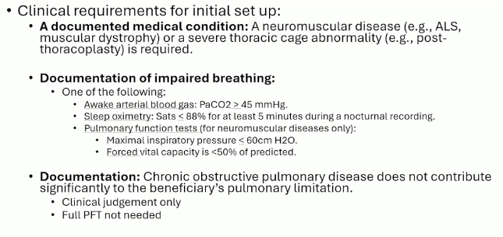
Restrictive/NMD: RAD Initial Coverage – ABG, Oximetry & PFT Criteria
Current
Notes:
PRESENTER NOTES – Restrictive/NMD: RAD Initial Coverage – ABG, Oximetry & PFT Criteria
SLIDE SUMMARY:
This slide details the current LCD L33800 clinical requirements for initial RAD setup in patients with restrictive thoracic disorders (neuromuscular disease or severe thoracic cage abnormalities).
KEY TALKING POINTS:
1. CLINICAL REQUIREMENTS FOR INITIAL SETUP (Criteria A–C, ALL must be met):
Criterion A – Diagnosis:
• Documentation of a neuromuscular disease (e.g., ALS, muscular dystrophy, myasthenia gravis, SMA, post-polio) OR a severe thoracic cage abnormality (e.g., post-thoracoplasty for TB, kyphoscoliosis, fibrothorax)
Criterion B – Documentation of Impaired Breathing (ONE of the following):
• Awake arterial blood gas (ABG): PaCO2 ≥ 45 mmHg, done on prescribed FiO2
• Sleep oximetry: SpO2 ≤ 88% for ≥ 5 minutes of nocturnal recording (minimum 2-hour recording), on prescribed FiO2
• For progressive neuromuscular disease ONLY:
– Maximal inspiratory pressure (MIP) < 60 cm H2O, OR
– Forced vital capacity (FVC) < 50% predicted
Criterion C – COPD Exclusion:
• COPD does not contribute significantly to the beneficiary's pulmonary limitation
• This criterion distinguishes the restrictive/NMD pathway from the COPD pathway (NCD 240.9)
2. IMPORTANT NUANCE – "Full PFT not needed":
• The LCD does NOT require a complete pulmonary function test panel
• Only the specific measures listed above (ABG, oximetry, MIP, or FVC) are needed to qualify
• This is a common source of confusion – providers sometimes delay referral thinking a full PFT workup is required
• For ALS patients in particular, full PFT may be impractical; MIP or FVC alone can suffice
3. DEVICE COVERAGE:
• If all criteria A–C are met, either an E0470 (without backup rate) or E0471 (with backup rate) is covered
• Device selection is at the treating practitioner's judgment – no LCD-mandated distinction for restrictive/NMD
• Coverage is for the first 3 months; continued coverage requires 61-day re-evaluation (see next slide)
4. PRACTICAL CONSIDERATIONS FOR PROVIDERS:
• Ensure symptom documentation (hypersomnolence, fatigue, headache, cognitive dysfunction, dyspnea) is in the chart BEFORE ordering testing – this is a prerequisite
• ABG must be done while AWAKE and on prescribed FiO2
• Oximetry must be NOCTURNAL with minimum 2-hour recording
• MIP/FVC pathway is ONLY available for progressive neuromuscular disease, not for thoracic cage abnormalities
Source: LCD L33800 – Respiratory Assist Devices
Reference: https://www.cms.gov/medicare-coverage-database/view/lcd.aspx?LCDId=33800

Slide 16
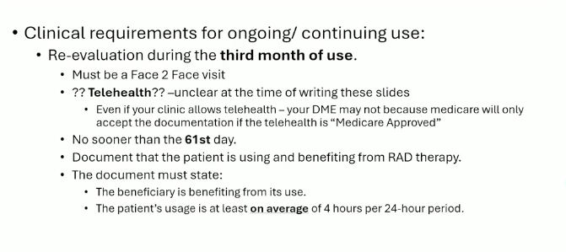
Restrictive/NMD: Continued Coverage Re-Evaluation & Telehealth
Current
Notes:
LCD L33800 – RESTRICTIVE THORACIC DISORDERS: CONTINUED COVERAGE & RE-EVALUATION
CONTINUED COVERAGE BEYOND FIRST 3 MONTHS:
Beneficiaries covered for the first 3 months of an E0470 or E0471 for restrictive thoracic disorders must be re-evaluated to establish medical necessity of continued coverage.
RE-EVALUATION REQUIREMENTS:
• Re-evaluation must occur no sooner than 61 days after initiating therapy
• Must be performed by the treating practitioner
• Medicare will NOT continue coverage for the 4th and succeeding months until re-evaluation is completed
CLINICAL REQUIREMENTS FOR RE-EVALUATION:
• Signed and dated statement by treating practitioner declaring:
– Patient is compliantly using the device (average of 4 hours per 24-hour period)
– Patient is benefiting from its use
• Objective evidence of benefit (e.g., improved gas exchange, symptoms, sleep quality)
TELEHEALTH CONSIDERATIONS:
• Status of telehealth for the re-evaluation visit is unclear at the time of writing
• Even if a clinic allows telehealth visits generally, Medicare DME re-evaluation requirements may require in-person assessment
• The re-evaluation must produce documentation sufficient to demonstrate continued medical necessity
• Providers should verify MAC-specific guidance on acceptable visit modalities for RAD re-evaluation
NOTE: These continued coverage requirements apply equally to restrictive thoracic disorders, CSA, CompSA, and hypoventilation syndrome – but NOT to COPD (which has separate criteria under NCD 240.9).
Source: LCD L33800 – Respiratory Assist Devices, Continued Coverage section

Slide 17
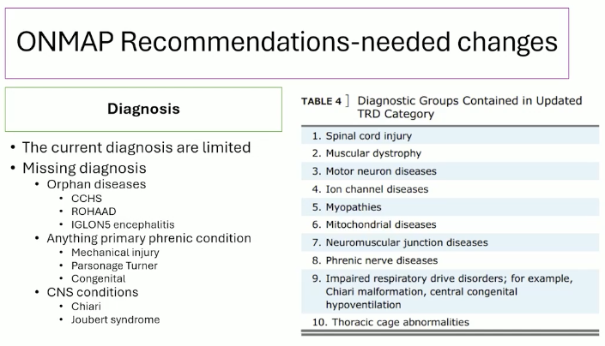
Restrictive/NMD: Qualifying Diagnoses – No Formal CMS List Exists
Notes:
PRESENTER NOTES – Restrictive/NMD: Qualifying Diagnoses – No Formal CMS List Exists
SLIDE SUMMARY:
This slide compares the current LCD L33800 diagnosis language (broad categories) with the NCD 240.9 Table 4 (specific enumerated diagnoses). A key finding from additional research: there is NO formal CMS checklist or closed list defining "severe thoracic cage abnormality." Coverage depends on clinical documentation, not a diagnosis-code whitelist.
—————————————————————————————
1. CURRENT LCD L33800 – DIAGNOSIS LANGUAGE:
The LCD uses BROAD, non-enumerated categories:
• "Neuromuscular disease" (e.g., ALS) – no closed list
• "Severe thoracic cage abnormality" (e.g., post-thoracoplasty for TB) – no closed list
The ICD-10-CM support codes section in the LCD and Policy Article A52517 lists codes as "N/A" – NOT as a qualifying diagnosis list.
2. NCD 240.9 TABLE 4 – ENUMERATED DIAGNOSES:
The NCD lists 10 specific neuromuscular/chest wall disorder categories:
1. ALS (Amyotrophic Lateral Sclerosis)
2. Muscular dystrophy
3. Post-polio syndrome
4. Myasthenia gravis
5. Multiple sclerosis
6. Spinal muscular atrophy
7. Spinal cord injury
8. Diaphragm paralysis
9. Myopathy
10. Thoracic cage abnormalities
IMPORTANT: It is unclear whether the LCD will adopt this expanded list for non-COPD indications or retain the current broad language. The NCD list is more specific but potentially more RESTRICTIVE than the LCD's open categorical language.
3. "SEVERE THORACIC CAGE ABNORMALITY" – WHAT QUALIFIES?
No current CMS/Noridian document defines this by a formal checklist or closed diagnosis list.
At the national level, NCD 280.1 covers ventilators for "thoracic restrictive diseases" but does not enumerate qualifying diagnoses. The 2025 COPD NCD leaves non-COPD indications to MAC discretion rather than creating a national list.
The closest official CMS material is the CMS NIPPV Technology Assessment, which describes thoracic restrictive disease as including:
• Post-thoracoplasty / post-TB thoracic sequelae (the only example in L33800)
• Kyphoscoliosis
• Fibrothorax
• Other severe chest wall deformities functioning like the above
Best reading: "severe thoracic cage abnormality" means a structural chest wall disorder causing restrictive ventilatory impairment and chronic hypoventilation – NOT a diagnosis-code whitelist.
4. WHAT "SEVERE" MEANS – NO NUMERIC THRESHOLD:
The LCD does NOT quantify "severe." The only numeric marker found in CMS-reviewed literature was one kyphoscoliosis study using Cobb angle >90°, but CMS did not adopt any numeric deformity threshold into L33800.
5. CONDITIONS NOT CLEARLY COVERED:
Conditions that may need separate advocacy for LCD inclusion:
• Central hypoventilation syndromes (CCHS, ROHHAD, IGLON5)
• Phrenic nerve conditions
• Joubert syndrome
These do not fit neatly into either "neuromuscular disease" or "thoracic cage abnormality" as currently defined.
6. PHYSIOLOGIC QUALIFICATION PATHWAYS BY DIAGNOSIS TYPE:
• Neuromuscular disease: ABG (PaCO2 ≥45), nocturnal oximetry (SpO2 ≤88%), OR MIP/FVC
• Severe thoracic cage abnormality: ABG or nocturnal oximetry ONLY – the FVC/MIP pathway is LIMITED to neuromuscular disease
7. PRACTICAL DOCUMENTATION TAKEAWAY:
Do NOT ask whether the diagnosis name appears on a published list – there is no current list. Instead, the record must clearly show:
(a) A documented severe structural chest wall abnormality (or neuromuscular disease), AND
(b) The required physiologic qualification route (ABG, oximetry, or MIP/FVC for NMD only)
A useful next step would be a clinic documentation phrase set that ties these findings to the Noridian audit standard.
Source: LCD L33800; NCD 240.9 Table 4; NCD 280.1; CMS NIPPV Technology Assessment; Policy Article A52517

Slide 18
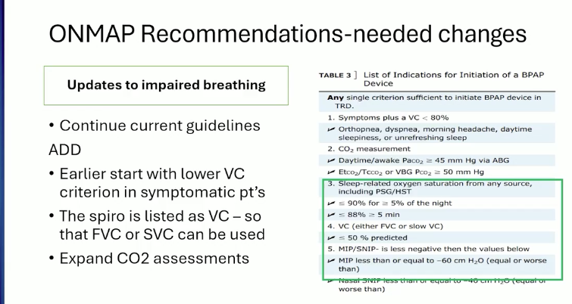
Restrictive/NMD: ONMAP Testing Recommendations & Table 3 Criteria
Notes:
PRESENTER NOTES – Restrictive/NMD: ONMAP Testing Recommendations & Table 3 Criteria
SLIDE SUMMARY:
This slide compares the current LCD L33800 testing requirements for impaired breathing with the expanded testing modalities recommended by ONMAP (Optimal NIV Medicare Access Promotion). The right side shows NCD 240.9 Table 3, which lists the objective measures of impaired breathing that CMS has recognized. This is directly relevant to our TcCO2 paper, especially for ALS patients.
—————————————————————————————
1. CURRENT LCD TESTING (CONTINUE AS-IS):
• Awake ABG: PaCO2 ≥ 45 mmHg on prescribed FiO2
• Nocturnal sleep oximetry: SpO2 ≤ 88% for ≥ 5 minutes (minimum 2-hour recording)
These remain the baseline qualification tests under L33800.
2. ONMAP RECOMMENDED ADDITIONS – EXPANDED CO2 ASSESSMENT:
ONMAP advocates adding these alternative CO2 measurement methods:
• End-tidal CO2 (EtCO2) ≥ 45 mmHg
• Transcutaneous CO2 (TcCO2) ≥ 45 mmHg
• Venous blood gas (VBG) CO2 ≥ 48 mmHg (with venous-arterial correction factor)
WHY THIS MATTERS:
• ABG is invasive, painful, and not always practical (especially in ALS patients with limited mobility)
• TcCO2 and EtCO2 are non-invasive, can be done in clinic or at home
• VBG is less invasive than ABG and widely available
• Expanding modalities removes a significant barrier to timely qualification
3. SPIROMETRY NOTE – VC vs. FVC vs. SVC:
• Table 3 lists the spirometry measure as "VC" (vital capacity)
• This means EITHER FVC (forced vital capacity) or SVC (slow vital capacity) can be used
• This is important for NMD patients – SVC is often more accurate than FVC in patients with neuromuscular weakness because they cannot generate the forced expiratory effort needed for reliable FVC
• SVC ≤ 50% predicted would qualify under the expanded criteria
4. NCD TABLE 3 – IMPAIRED BREATHING OBJECTIVE MEASURES:
The table on the right lists all recognized measures:
• PaCO2 ≥ 45 mmHg (arterial blood gas)
• SpO2 ≤ 88% for ≥ 5 minutes nocturnal recording
• FVC (or SVC) < 50% predicted
• MIP (maximal inspiratory pressure) worse than -60 cm H2O
• SNIP (sniff nasal inspiratory pressure) worse than -40 cm H2O
• MEP (maximal expiratory pressure) criteria
• Peak cough flow measurements
Note: MIP and SNIP are particularly useful for progressive NMD – they detect diaphragm weakness earlier than spirometry.
5. RELEVANCE TO TcCO2 PAPER:
• ONMAP's advocacy for TcCO2 as a qualifying modality directly supports our research
• If adopted into LCD revisions, TcCO2 monitoring would become a valid pathway to RAD qualification
• ALS patients stand to benefit most – TcCO2 is non-invasive, tolerable, and can track progression over time
• Our modeling data can demonstrate that TcCO2 correlates with ABG PaCO2 in this population
• This slide provides the policy context for why expanding testing modalities matters clinically
6. CURRENT STATUS:
• These expanded modalities are ONMAP recommendations, not yet adopted into LCD L33800
• Table 3 appears in the NCD but applies to COPD; whether MACs adopt it for restrictive/NMD remains to be determined
• LCD revisions expected October 2025 – watch for inclusion of expanded testing methods
Source: NCD 240.9 Table 3; ONMAP Recommendations; LCD L33800

Slide 19
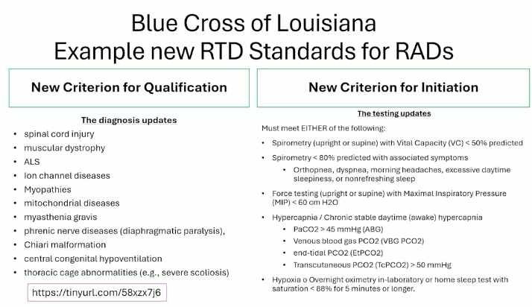
Restrictive/NMD: Louisiana BCBS Independent Coverage Changes
Notes:
BLUE CROSS BLUE SHIELD OF LOUISIANA – INDEPENDENT COVERAGE CHANGES FOR RESTRICTIVE/NMD
Blue Cross of Louisiana has made changes to their respiratory device coverage criteria SEPARATELY from the national CMS determination. This is notable because it shows payer-level movement independent of the NCD/LCD process.
SOURCE: https://tinyurl.com/58xzx7j6
DIAGNOSIS UPDATES (LEFT COLUMN):
• Louisiana BCBS expanded their qualifying diagnosis list for RAD/NIV coverage
• Includes neuromuscular diseases, thoracic restrictive disorders, and potentially broader categories than the current LCD L33800
• Specific conditions added or clarified in their medical policy
TESTING UPDATES / NEW CRITERION FOR INITIATION (RIGHT COLUMN):
• Updated criteria for documenting impaired breathing
• Expanded testing modalities beyond traditional ABG and sleep oximetry
• New initiation criteria that may include:
– Transcutaneous CO2 monitoring
– End-tidal CO2
– Updated spirometry thresholds (FVC, MIP)
– Hypoxia criteria updates
KEY SIGNIFICANCE:
• Demonstrates that individual payers can and do update respiratory device coverage independently of CMS national/local determinations
• Louisiana BCBS changes may serve as a model or precedent for other payers
• Shows industry movement toward modernized testing and expanded diagnosis criteria even before LCD revisions take effect
• Relevant to advocacy efforts – can cite payer-level precedent when engaging with MACs on LCD updates
NOTE: These are Blue Cross Blue Shield of Louisiana commercial/MA plan changes, not Medicare FFS. Medicare FFS remains governed by LCD L33800 until MAC revisions are finalized.

Slide 20
Restrictive/NMD: Additional LCD L33800 Provisions
Prerequisite: Documented Symptoms
LCD requires symptoms of sleep-associated hypoventilation documented before testing
Qualifying symptoms: daytime hypersomnolence, excessive fatigue, morning headache, cognitive dysfunction, dyspnea
5-Year RUL Device Replacement
In-person evaluation required documenting continued use & benefit
No new testing required; new prescription is required
Pre-Medicare Enrollment Transitions
Claims treated as new initial rentals – not automatic transitions
Prior testing allowed if it meets current coverage criteria at time of claim
E0470 vs. E0471 & NCD 280.1 Ventilator Overlap
Either E0470 or E0471 at practitioner discretion (no LCD-mandated distinction)
NCD 280.1 ventilator codes (E0465/E0466/E0467) overlap with RAD disease groups

Slide 21
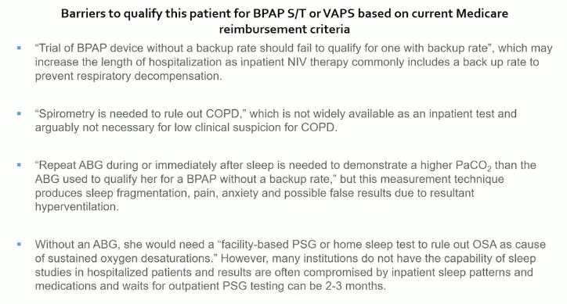
OHS qualification - RAD
Not much interest in a new NCD for OHS
So reimbursement criteria .

Slide 22
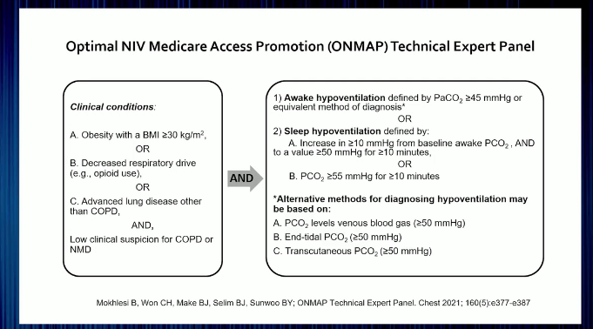
OHS – ONMAP recs (not operative, but what we wish it was)

Slide 23
Hypoventilation Syndrome: Current LCD RAD Coverage (L33800)
E0470 (without backup rate) – Criteria A, B, and C or D:
A. Awake ABG PaCO2 ≥ 45 mmHg on prescribed FiO2
B. Spirometry FEV1/FVC ≥ 70% (rules out COPD as primary cause)
C. Sleep/awakening ABG PaCO2 worsens ≥ 7 mmHg vs. criterion A; OR
D. PSG/HST: SpO2 ≤ 88% for ≥ 5 min (min 2-hr recording), AHI < 5
E0471 (with backup rate) – Must try E0470 first:
A. Covered E0470 device is currently being used
B. Spirometry FEV1/FVC ≥ 70%
C. Awake PaCO2 worsens ≥ 7 mmHg vs. E0470 qualifying ABG; OR
D. PSG/HST: SpO2 ≤ 88% ≥ 5 min, AHI < 5 while on E0470
Key: E0471 requires documented E0470 failure first
Notes:
PRESENTER NOTES – Hypoventilation Syndrome: Current LCD RAD Coverage (L33800)
SLIDE SUMMARY:
This slide outlines the current LCD L33800 criteria for RAD coverage in hypoventilation syndrome. Unlike restrictive/NMD (which allows either E0470 or E0471 at practitioner discretion), hypoventilation syndrome has a STEP THERAPY requirement: E0470 must be tried first, and E0471 requires documented failure on E0470.
—————————————————————————————
1. E0470 INITIAL COVERAGE (ALL of A & B, plus C or D):
A. AWAKE ABG: PaCO2 ≥ 45 mmHg, done while awake on prescribed FiO2
• This is the SAME threshold as restrictive/NMD
• Must be arterial blood gas, not venous or transcutaneous (under current LCD)
B. SPIROMETRY: FEV1/FVC ≥ 70%
• This is UNIQUE to hypoventilation syndrome – not required for restrictive/NMD
• Purpose: rules out significant obstructive disease (COPD) as the primary cause
• If FEV1/FVC < 70%, the patient should be evaluated under the COPD pathway instead
C. SLEEP/AWAKENING ABG: PaCO2 worsens ≥ 7 mmHg compared to the awake ABG in criterion A
• Done during sleep or immediately upon awakening
• Demonstrates nocturnal hypoventilation beyond the baseline daytime value
– OR –
D. PSG or HOME SLEEP TEST: SpO2 ≤ 88% for ≥ 5 minutes of nocturnal recording (minimum 2-hour recording), NOT caused by obstructive upper airway events (AHI < 5)
• The AHI < 5 requirement is critical – it confirms the desaturation is from hypoventilation, not OSA
• If AHI ≥ 5, the patient may need OSA treatment first (see PAP LCD)
2. E0471 UPGRADE – STEP THERAPY REQUIRED:
Unlike restrictive/NMD where either device is covered at practitioner discretion, hypoventilation syndrome REQUIRES:
A. A covered E0470 device is already being used (must demonstrate E0470 was tried)
B. Spirometry confirms FEV1/FVC ≥ 70% (re-confirm not COPD)
C. Despite E0470 use, awake PaCO2 worsens ≥ 7 mmHg vs. the original qualifying ABG
– OR –
D. Despite E0470 use, PSG/HST still shows SpO2 ≤ 88% for ≥ 5 min with AHI < 5
This means the patient must FAIL on E0470 before E0471 with backup rate is covered.
3. KEY DIFFERENCES FROM OTHER INDICATIONS:
vs. Restrictive/NMD:
• Hypoventilation requires spirometry (FEV1/FVC ≥ 70%) – NMD does not
• Hypoventilation requires E0470 trial before E0471 – NMD allows either at practitioner discretion
• Hypoventilation does not have the MIP/FVC alternative pathway that progressive NMD has
vs. COPD:
• Hypoventilation uses PaCO2 ≥ 45 mmHg (same as NMD) vs. COPD's ≥ 52 mmHg
• The FEV1/FVC ≥ 70% requirement is what separates hypoventilation from COPD patients
4. COMMON HYPOVENTILATION SYNDROME DIAGNOSES:
• Obesity hypoventilation syndrome (OHS) – most common
• Central hypoventilation (non-congenital)
• Drug/medication-induced hypoventilation
• Metabolic hypoventilation syndromes
5. CONTINUED COVERAGE:
• Same 61-day re-evaluation requirement as restrictive/NMD and CSA/CompSA
• Must document compliance (≥ 4 hrs/day average) and clinical benefit
• Medicare will not continue coverage beyond 3 months without re-evaluation
6. PRACTICAL DOCUMENTATION TIPS:
• Always get the awake ABG FIRST (criterion A) – it serves as baseline for the ≥ 7 mmHg worsening comparison
• Spirometry must be done to rule out COPD – do not skip this step
• For criterion D, ensure the sleep study reports AHI separately – an AHI ≥ 5 means OSA must be addressed first
• If upgrading to E0471, document clearly that E0470 was tried and why it was insufficient
Source: LCD L33800 – Respiratory Assist Devices, Hypoventilation Syndrome section
Reference: Noridian Dear Clinician Letter – RADs for Hypoventilation Syndrome

